Slide 1
sonic [art] liberation
merging mind & matter through the multisense

Slide 2
“The task before us is not so much to make things, and resolve relations into things, more and more minutely framed and microscopically understood; rather, it may be to liberate matter from the constraint, the practicality, the utility of the thing, to orient technology not so much to knowing and mediating as to experience and the rich indeterminacy of duration, to making without definitive end or goal... “ –Elizabeth Grosz

Slide 3
What is sound [art] doing?

Slide 4
Dismantling form
Compositional
Spatial
Conceptual
Social
Environmental
Technological
Bodily
Sensorial
Perceptive

Slide 5
Disappearance
“the aesthetics of disappearance” [Kuma]
“the anti-object”
Focus to relationships & interactions
Experiential ephemeral
Affect vs visual aesthetics
Mental imagery, memory, presence

Slide 6
“To listen is to enter that spatiality by which, at the same time, I am penetrated, for it opens up in me as well as around me, and from me as well as toward me: it opens me inside me as well as outside, and it is through such a double, quadruple, or sextuple opening that a “self” can take place.”
–Jean Luc Nancy

Slide 7
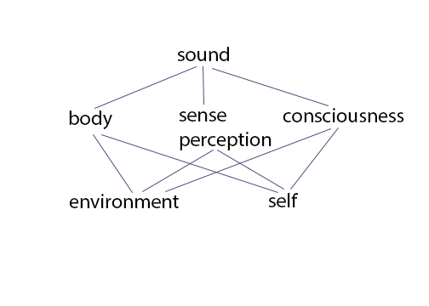

Slide 8
“Sense is an awareness of being aware, a conception that fits its most comfortable expression in the reverberant expanded situation of sound--- as we’ve known since Aristotle, sensing is always a perception, that is- a feeling-oneself-feel.” -Ferrari

Slide 9
Liberating Body.
Full body engagement
Universal vs subjective body
Listener’s physical navigation
Body as instrument or artwork: biorhythms – interactive response systems
Puts listener within, not outside of the art
Voyeur vs. voyee

Slide 10
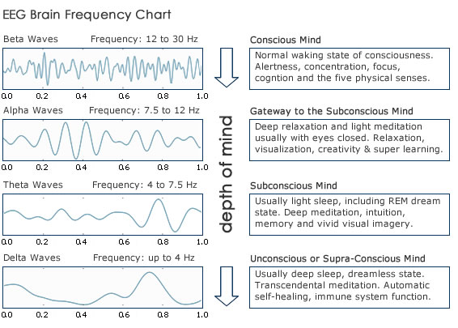

Slide 11
Liberating Interaction.
Often removes performer, participant mid-experience
Subject/object roles redefined
Investigative, exploratory, transitory
Unravelled social conventions, musical-social conventions
Orientation shifts experience
Spatial Navigation/Time

Slide 12
Liberating Space-Time
Circular/cyclical
Synchronic Time, Ongoing duration
Lost sense
Past, Present, Future imagined in the present

Slide 13
Engaging Chance
Using unpredicability of site-specificity, response to daily sounds, acoustics of natural space
Spatiotemporal development and response
“in-between” space
Happenstance engagement
Creates art experience beyond what an individual can perceive/predict

Slide 14
Displacement
Intervention: One environment inner or outer, inserted into another
Recordings vs Acoustic sound
Not just an imagined reality of an artwork, but what is imagined it is also realized.

Slide 15
Art or Reality?

Slide 16
Liberating Spirit.
Simultaneous experience of transcendence or “out of body” experience and physical bodily experience
Access to the “inner self”, and unified whole
Sense of connection, heightened awareness

Slide 17
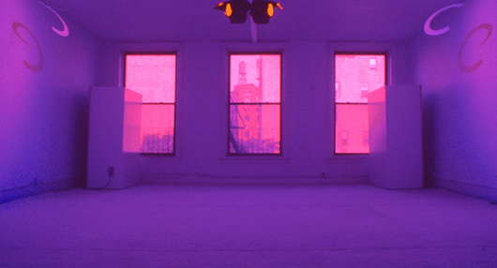
La Monte Young, “Dreamhouse”

Slide 18
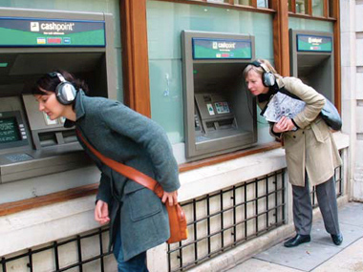
Christina Kubisch, “Electrical Walks”

Slide 19
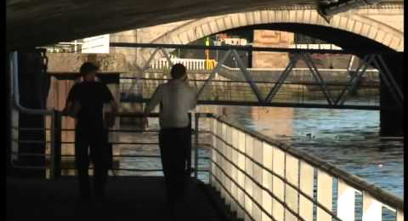
Susan Philipsz, “Lowlands”

Slide 20
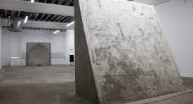
Tim Bruniges, “Mirrors”

Slide 21
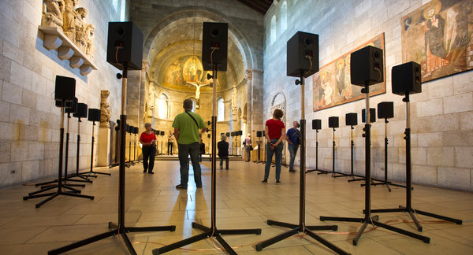
Janet Cardiff, “40 Part Motet”
Notes:
https://www.youtube.com/watch?v=5BGjs37TRlA

Slide 22
Dewey, John. Art As Experience (1934)
Varese, Edgar. The Liberation of Sound (1939)
Merleau-Ponty, Maurice. Phenomenology of Perception (1945)
Nancy, Jean-Luc. Listening & Being Singular Plural (2000)
Truax, Barry, Acoustic Communication (2000)
Grosz, Elizabeth. Time Travels (2005)
‪
Licht, Alan. Sound Art: Beyond Music Between Categories (2007)
Cox, Christoph. Sound Art and the Sonic Unconscious (2009)
Suisman, Strasser. Sound in the Age of Mechanical Reproduction (2011)

Slide 23
Jennifer Grossman / sound/multi-media artist
e: jenn8grossman@gmail.com
w: jenngrossman.wix.com/sound

